Slide 1
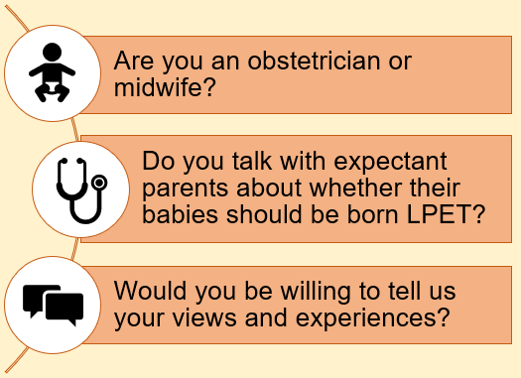
Parental Involvement in decision-making about Planned late preterm and early term birth: the ‘PIP’ study
If so, or for more information, please contact Dr Frances Mielewczyk:
Tel: 0116 252 5468 Email: fjm13@le.ac.uk : @Frajmie

